Slide 1
Data Representation
Data Types
Complements
Fixed Point Representation

Slide 2
Data Types
Binary information in digital computers is stored in memory or registers.
The data types found in digital registers or memory is classified as one of the following types:
Numbers used in arithmetic computation
Letters of alphabets used in data processing
Other symbols used for specific purpose

Slide 3
Data Types
A number system of base or radix (r) is a system that uses distinct symbols for r digits
Binary ->0,1
Octal->0,1,2,3,4,5,6,7
Decimal->0,1,2,3,4,5,6,7,8,9
Hexadecimal->0,1,2,3,4,5,6,7,8,9,A,B,C,D,E,F

Slide 4
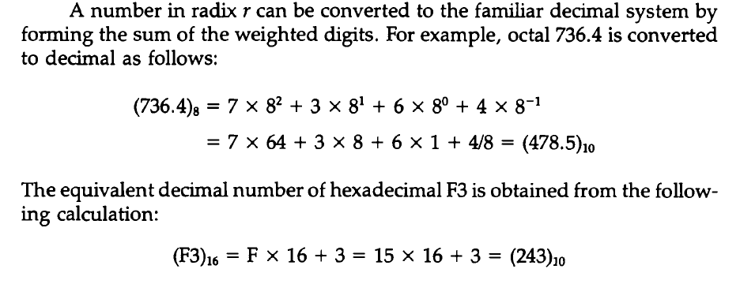
Data Types

Slide 5
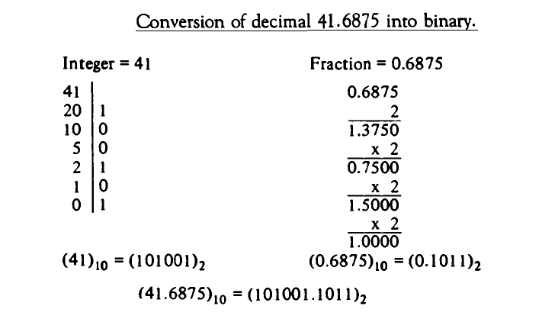
Data Types

Slide 6
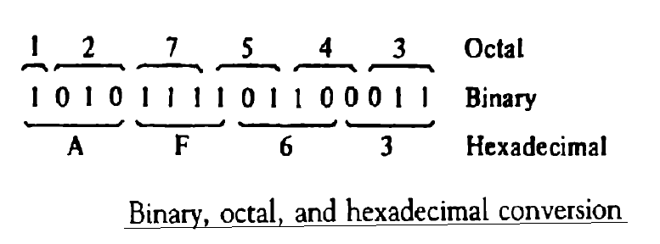
Data Types

Slide 7
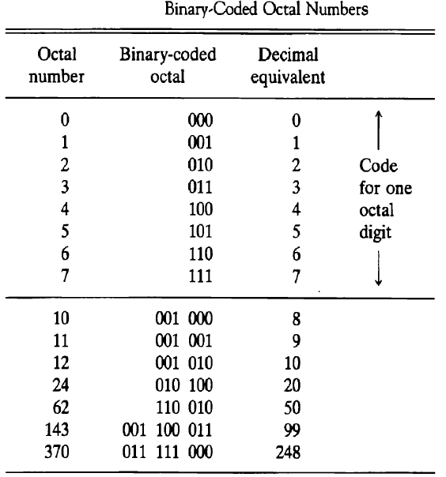
Data Types

Slide 8
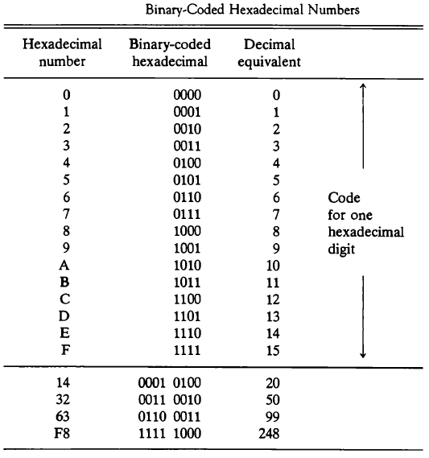
Data Types

Slide 9
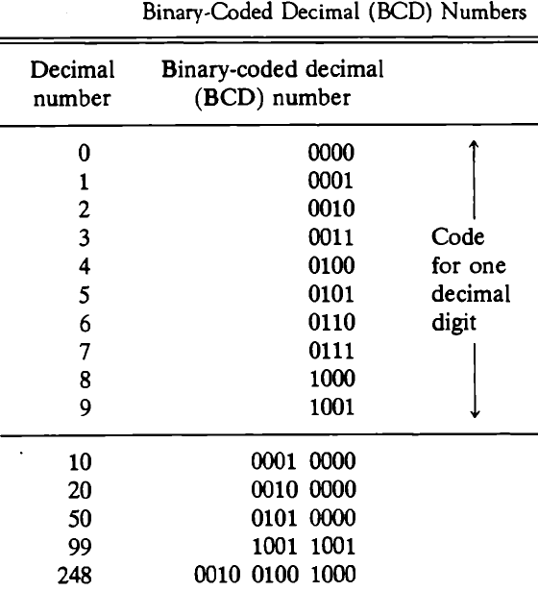
Data Types

Slide 10
Data Types
Many application of digital computers require the handling of data that consists not only of numbers but also letters of alphabets and certain special characters.
The standard alphanumeric binary code is ASCII(American Standard code for Information Interchange)which uses 7 bits to code 128 characters.

Slide 11
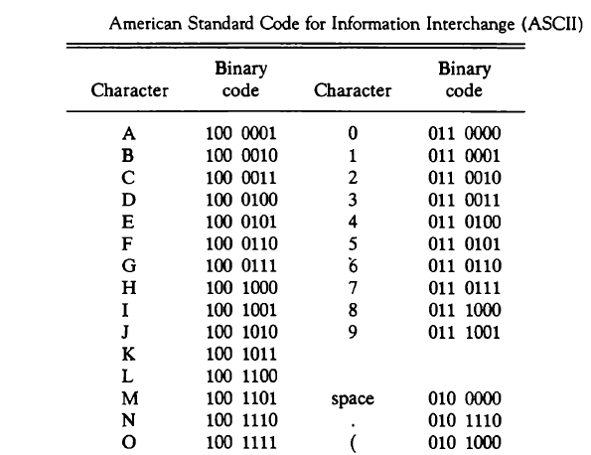
Data Types

Slide 12
Complements
Complements are used in digital computers for simplifying the subtraction operation.
There are two types of complement for base r-system
(r-1)’s complement
r’s complement

Slide 13
Complements
Let’s suppose a given number N in base r having n digits, the (r-1)’s complement of N is defined as (r^n-1)-N.
(r-1)’s complement can be achieved as:
Subtracting each digit from 9(for decimal)
Subtracting each digit from 1(for binary)
Subtracting each digit from 7(for octal)
Subtracting each digit from F(15)(for hexadecimal)

Slide 14
Complements
 r’s complement of n-digit number N in base r is defined as r^n-N
 r^n-N = (r^n-1)-N+1 = (r-1)’s complement + 1

Slide 15
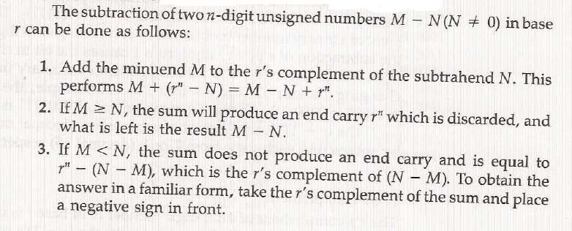
Complements

Slide 16
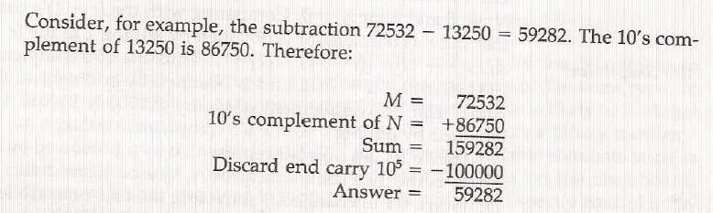
Complements

Slide 17
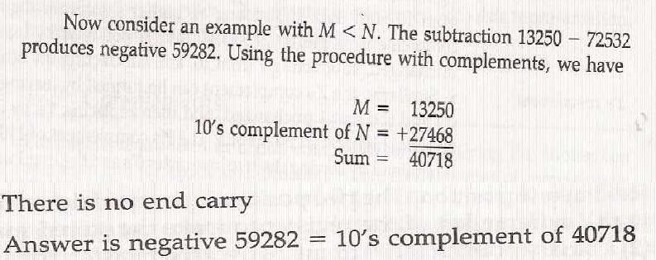
Complements

Slide 18
Fixed Point Representation
Sign bit placed in the leftmost position of the number determine if the number is positive or negative. It is 1 for negative and o for positive.
In addition to sign bit a number may have decimal or binary point. There are two ways of specifying the position of the binary point in register.
By giving it fixed position
By employing floating point representation

Slide 19
Fixed Point Representation
The fixed point assumes one of the following case:
Binary point in the extreme left to make stored number fraction .
Binary point in extreme right to make the stored number an integer
Floating point representation uses the second register to store a number that designates the position of the binary point.

Slide 20
Fixed Point Representation
When an integer binary number is positive, sign is represented by o and magnitude by positive binary number.
When it is negative sign bit is represented by 1 and rest of the number can be represented in one of the following ways:
Signed-Magnitude Representation
Signed-1’s Complement Representation
Signed-2’s Complement Representation

Slide 21
Fixed Point Representation
There is only one way to represent +14(0 0001110) in 8-bit register.
There are 3 different ways to represent -14 with 8 bits:
Signed Magnitude Representation: 1 0001110
Signed 1’s Complement Representation: 1 1110001
Signed 2’s Complement Representation: 1 1110010

Slide 22
Fixed Point Representation
The 1’s complement imposes difficulties because it has two representation of 0(+0[0000] and -0[1111]).
It is seldom used in arithmetic operation except in some older compilers.
It is useful in logical operation since change from 1to 0, 0 to 1 is equivalent to logical complement function.

Slide 23
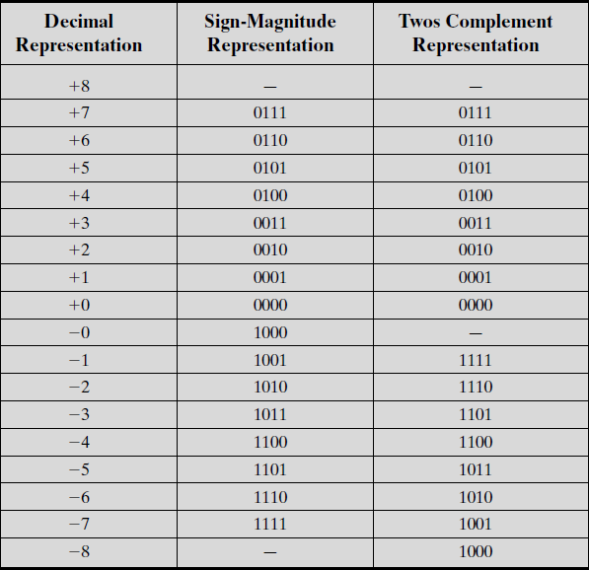
Fixed Point Representation

Slide 24
Fixed Point Representation
Sometime there is need to convert the data from one bit length to another(4 bit to 8 bit etc.)
This conversion is very simple to apply in case of signed magnitude representation, just shifting of the signed bit is required.
But this method won’t be applicable in case of signed 2’complement.
In the case of 2’s complement representation, the process called sign extension is implemented.

Slide 25
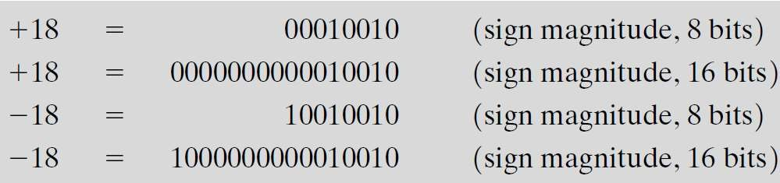
Fixed Point Representation

Slide 26
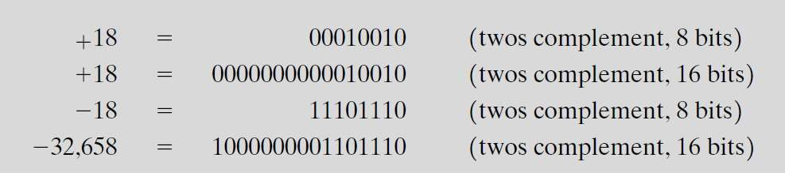
Fixed Point Representation

Slide 27
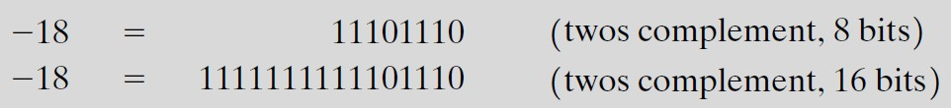
Fixed Point Representation

Slide 28
Arithmetic Addition
Adding the numbers in signed 2’s complement system require only addition and complementation.
Add the two numbers, including their sign bits.
Discard any carry out of the sign(leftmost) bit position. Note:
Negative numbers must initially be in 2’s complement and if the sum obtained after the addition is negative it is in 2’s complement form.

Slide 29
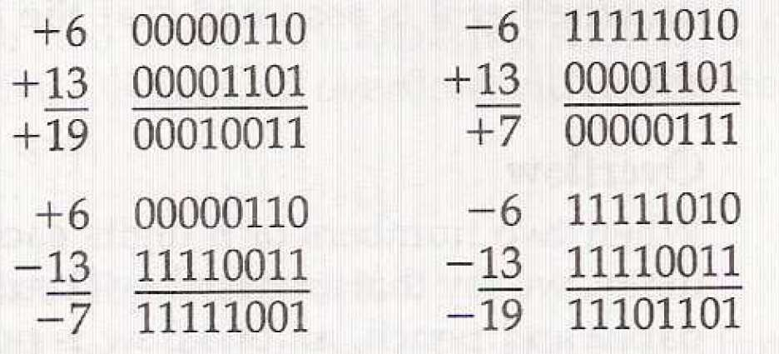
Arithmetic Addition

Slide 30
Arithmetic Subtraction
2’s complement subtraction includes following steps:
Take the 2’s complement of number to be subtracted including the sign bit.
Add it the next number.
Discard the carry out of the sign bit position

Slide 31
Arithmetic Subtraction
 -6-(-13)=+7
-6
2’s complement of -13
11111010
00001101
00000111

Slide 32
THANK YOU

